Slide 1
Open addressing

Slide 2
Outline
Chained hash tables require special memory allocation
Can we create a hash table without significant memory allocation?
We will deal with collisions by storing collisions elsewhere
We will define an implicit rule which tells us where to look next

Slide 3
Background
Explicitly storing references to the next object due to a collision requires memory
Linked lists require a pointer to the next node
Scatter tables require a pointer to the next cell
We will implicit rules which dictate where to look next

Slide 4
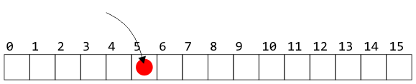
Open Addressing
Suppose an object hashes to bin 5
If bin 5 is empty, we can copy the object into that entry

Slide 5
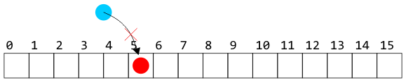
Open Addressing
Suppose, however, another object hashes to bin 5
Without a linked list, we cannot store the object in that bin

Slide 6
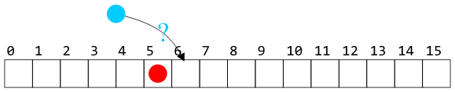
Open Addressing
We could have a rule which says:
Look in the next bin to see if it is occupied
Such a rule is implicit—we do not follow an explicit link

Slide 7
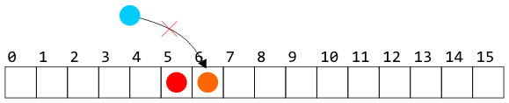
Open Addressing
The rule must be general enough to deal with the fact that the next cell could also be occupied
For example, continue searching until the first empty bin is found
The rule must be simple to follow—i.e., fast

Slide 8
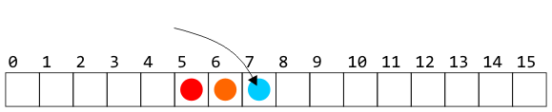
Open Addressing
We could then store the object in the next location
Problem: we can only store as many objects as there are entries in the array: the load factor λ ≤ 1

Slide 9
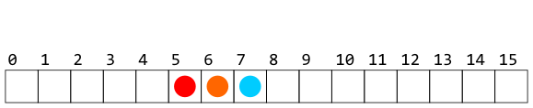
Open Addressing
Of course, whatever rule we use in placing an object must also be used when searching for or removing objects

Slide 10
Open Addressing
Recall, however, that our goal is Θ(1) access times
We cannot, on average, be forced to access too many bins

Slide 11
Open Addressing
There are numerous strategies for defining the order in which the bins should be searched:
Linear probing
Quadratic probing
Double hashing
There are many alternate strategies, as well:
Last come, first served
Always place the object into the bin moving what may be there already
Cuckoo hashing

Slide 12
Summary
This short topic introduces the concept of open addressing
Use a predefined sequence of bins which should be searched
We need a fast rule that can be easily followed
We must ensure that we are not making too many searches
The load factor will never be greater than one

Slide 13
References
Wikipedia, http://en.wikipedia.org/wiki/Hash_function
[1] Cormen, Leiserson, and Rivest, Introduction to Algorithms, McGraw Hill, 1990.
[2] Weiss, Data Structures and Algorithm Analysis in C++, 3rd Ed., Addison Wesley.
These slides are provided for the ECE 250 Algorithms and Data Structures course. The material in it reflects Douglas W. Harder’s best judgment in light of the information available to him at the time of preparation. Any reliance on these course slides by any party for any other purpose are the responsibility of such parties. Douglas W. Harder accepts no responsibility for damages, if any, suffered by any party as a result of decisions made or actions based on these course slides for any other purpose than that for which it was intended.

